Slide 1
Noise Pollution Monitoring
Presented by
Ramar

Slide 2
IoT integration
You can integrate your IoT-based noise pollution monitoring system with a cloud platform, such as AWS IoT Core or Azure IoT Hub. This will allow you to store the sound level readings in the cloud and access them from anywhere.
To integrate your system with a cloud platform, you will need to create an account on the platform and obtain the necessary credentials. You will then need to install the cloud platform's client library on your Arduino board or Raspberry Pi.
Once you have installed the client library, you can write code to connect to the cloud platform and publish the sound level readings. You can also write code to subscribe to cloud platform alerts and take actions based on the alerts.
Example use cases
Here are some example use cases for an IoT-based noise pollution monitoring system:
Monitor the noise level in a city or neighborhood and send alerts to residents when the noise level exceeds a certain threshold.
Monitor the noise level in a factory or other industrial setting and take action to reduce the noise level if it is too high.
Monitor the noise level in a school or hospital and take action to reduce the noise level if it is disruptive.
Monitor the noise level in a wildlife habitat and take action to protect the wildlife if the noise level is too high.
You can use your creativity to come up with other use cases for an IoT-based noise pollution monitoring system.

Slide 3
To create an IoT-based noise pollution monitoring system using Python
Raspberry Pi or other single-board computer
Sound sensor
Breadboard and jumper wires
Internet connection
Cloud platform, such as AWS IoT Core or Azure IoT Hub
Python 3
PySerial library
Once you have all of the necessary components, you can follow these steps:
Connect the sound sensor to the Raspberry Pi.
Install the Python 3 and PySerial libraries on the Raspberry Pi.
Write a Python script that connects to the cloud platform and publishes the sound level readings.
Configure the Raspberry Pi to start the script on boot.

Slide 4
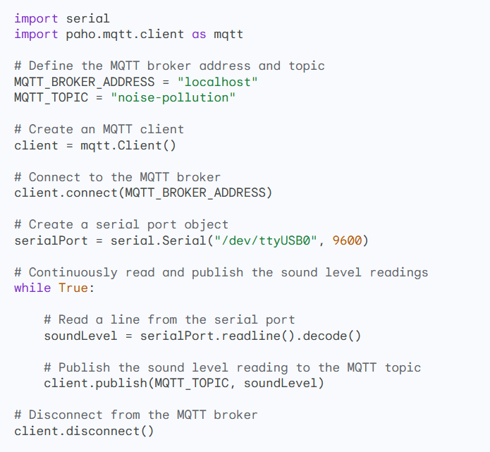
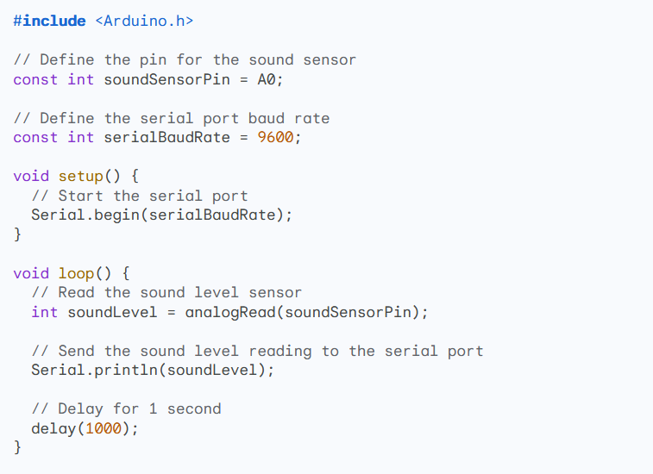
Python code C++ code

Slide 5

Configuration
To configure the Raspberry Pi to start the script on boot, you can add the following line to the /etc/rc.local file:

